Slide 1

Engaging and Informing
(and ‘what video can teach interfaces’)
Max Gadney
After the Flood
mg@aftertheflood.com

Slide 2
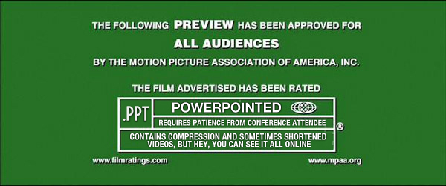

Slide 3
Media
Our Work
Engagement
Inform and
learn from
each other
Analytics
Depth

Slide 4
Media
This Talk
Engagement
Video design informs data product design
Analytics
1. Articulate data into stories
2. Show multi modal data
3. Present a human voice of data
4. Use visual strengths of medium
5. Spread data socially

Slide 5
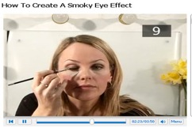

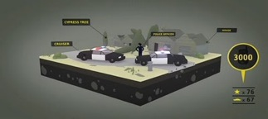
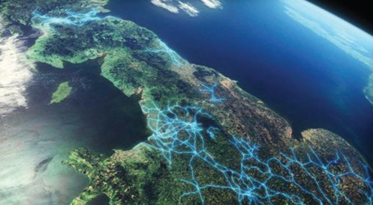


Context
How-to Videos
Short-form formats
Video Graphics
Data TV!
VOD mainstream
Social Video

Slide 6
Media
1/5
Articulate data into stories
Analytics

Slide 7

…a well told story keep us listening …

Slide 8
A story is the concept,
not the characters
2. Script
3. Voice/Sound
4. Graphics
5. Social Motive
1. Unifying Conceptual device

Slide 9
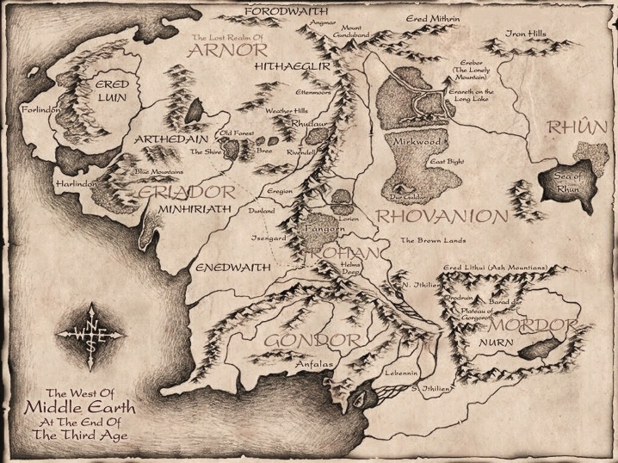
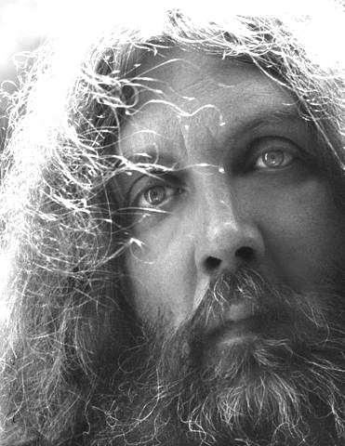

“It is easy to create a fictional world, but creating the red thread of story that goes through it is the hard bit”
- Alan Moore

Slide 10
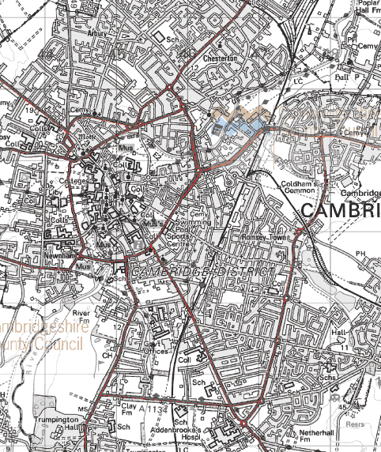
find the idea
1) - all very well if you are the expert)
2) - allow others to find the idea and the concept
3) - quant(x)=qual story needs a reason
- you need two axes of data – the Why AXIS
DON’T DO WHAT THE DATA WANTS TO DO – MIX IT UP
Data wants more than freedom

Slide 11

for example…

Slide 12
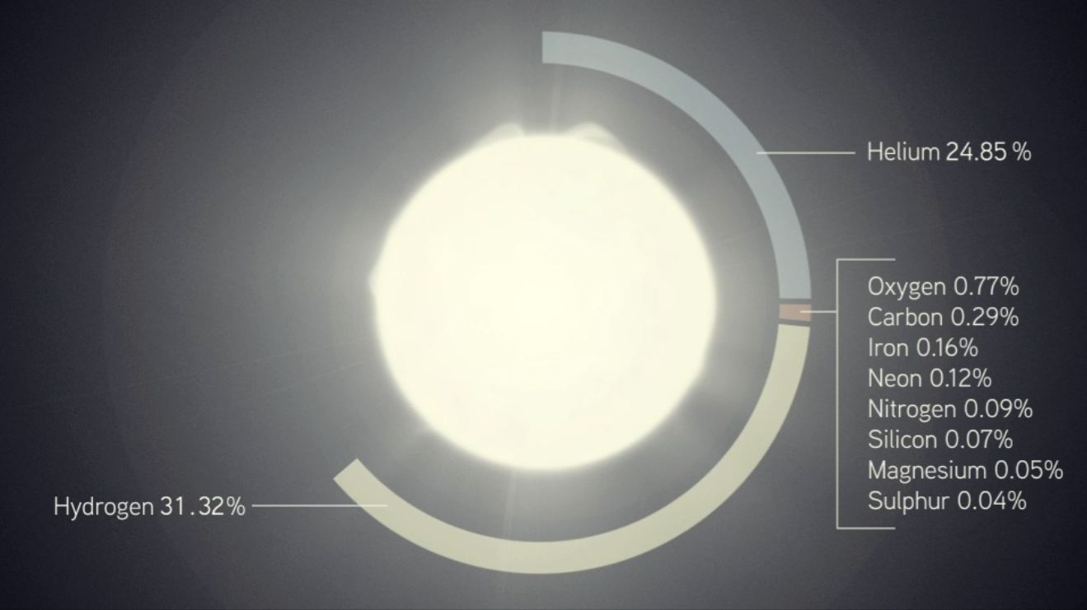
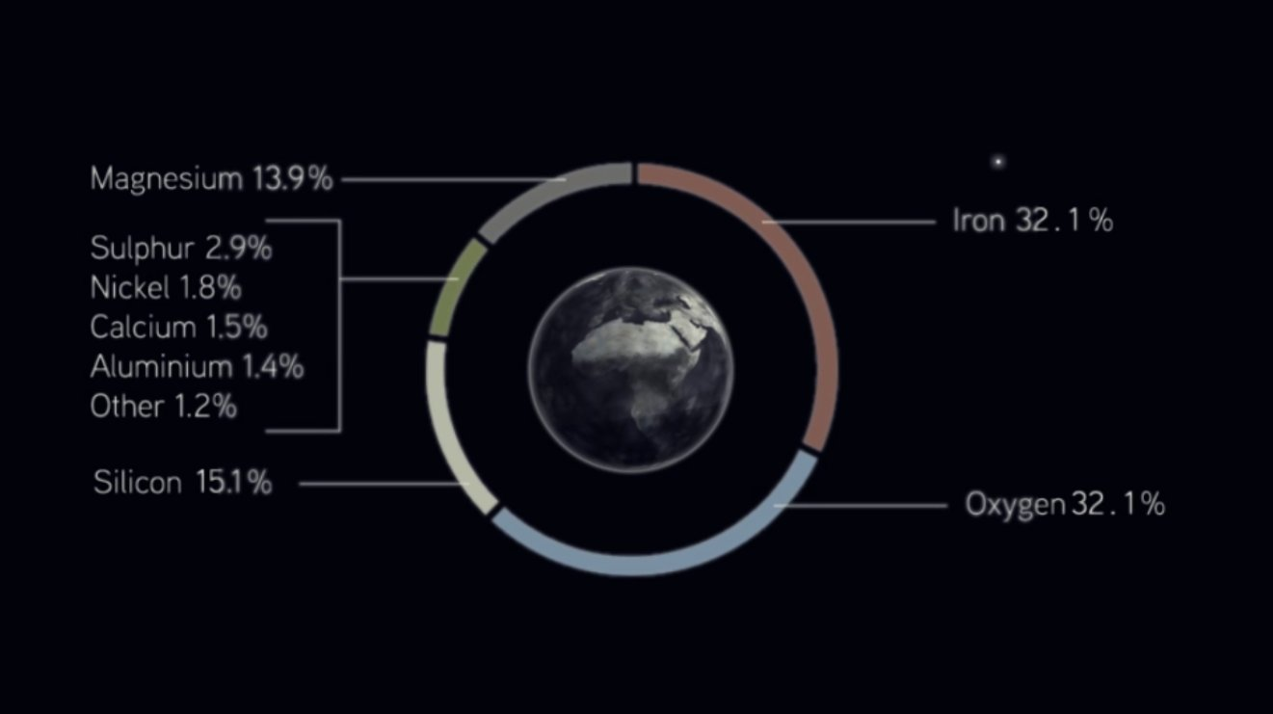
1. Content truth (distinction/difference)
Atomic level similarity
2. Concept – and Story arc
The stars make us – we are them and they are us
3 .Structural (Visual) concepts – guide the figure and ground/ data types
Earth Alive
Cold dead space
Earth Alive
4. Foreshadowing

Slide 13

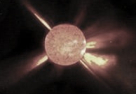



3 .Structural (Visual) concepts – guide the figure and ground/ data types
The stars make us – we are them and they are us
Earth Alive
Cold dead space
Earth Alive
Foreshadowing

Slide 14
The parti
Marketing | promise
Games | mission
TV | proposition
Film | High concept
NGO | purpose
Business | distinction
A clear idea clearly shown
“A data visualization should
only be beautiful when beauty
can promote understanding
in some way without
undermining it in another.”
Stephen Few

Slide 15

…a site’s story is it’s stated and consistent purpose…

Slide 16
Media
2/5
Analytics
Show multi-modal data

Slide 17
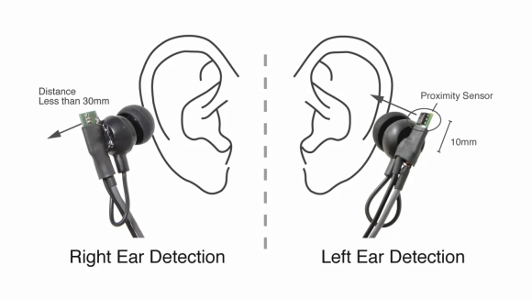
Cross the Streams
SHOW don’t and TELL
Pictures don’t and Words
QT don’t and QL
Data don’t and Interpretation

Slide 18
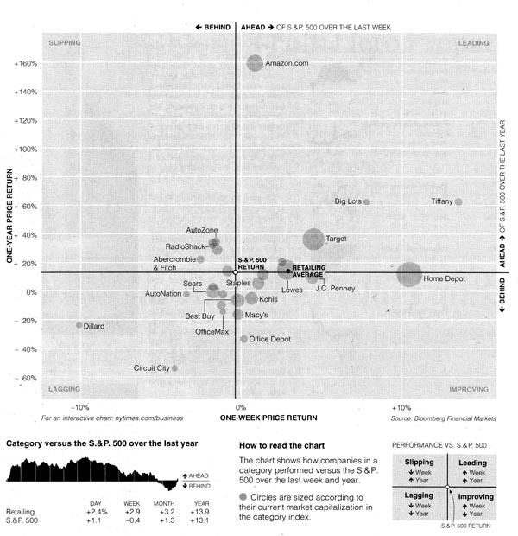
Living up to its reputation, January was a relatively stable month on Wall Street.
Volatility eased as investors appeared to take in stride the latest developments in the European debt crisis and persistent worries about economic growth.
At the same time, stocks motored through the month with slow but steady advances, logging in their biggest January gain since 1997.
Amid the calm, some analysts said there were signs that the market was poised for a pullback with choppy trading in the coming weeks.
One of the main gauges of market uncertainty, the so-called fear index, or VIX, settled at a reading of 19.44 on Tuesday after hovering at 18 last week, well below the average of 24 for the index in 2011. When the index fell below 20 on Jan. 19, it was the first time that it had dipped below that level since July.
“Nobody expected this period to be quite that dead,” Jamie Tyrrell, a VIX index trader, said.
Also absent were the gyrations that characterized price swings in stocks in the second half of 2011. The broadest gauge of the stock market, the Standard & Poor’s 500-stock index, budged more than 1 percent only on two trading days in January, and they were increases both times.
That makes it the quietest January since 2007, when the S.& P. moved at least 1 percent on just one day.
“The market definitely is holding its own, even though we start out poorly during the day,” said Howard Silverblatt, the senior index analyst for S.& P. indices.
The so-called January Barometer, created by Yale Hirsch of the Stock Traders Almanac — who coined the saying, “As January goes, so goes the year” — shows that of the 38 years since 1950 when the S.& P. has gone up in January, it has finished the year higher for 34 of those years.
The index finished up 4.4 percent for the month, even after falling for a fourth consecutive day on Tuesday to 1,312.41, or down by 0.05 percent. The Dow Jones industrial average was up 3.4 percent in January, closing on Tuesday at 12,632.91. The Nasdaq was up 8 percent for the month, after a slight 0.7 percent rise on Tuesday.
Liz Ann Sonders, the chief investment strategist for Charles Schwab, wrote in a market note that a palette of “technical, sentiment and simply fun” indicators, like the “golden cross” of moving averages, the Yale Crash Confidence Index and the Ned Davis Research Crowd Sentiment Poll, could show the market is vulnerable to a pullback in the near term, but it will likely remain a bull market with further gains.
Although concerns over Europe, bank and market liquidity, and the economy are still in play, traders said there was a sense that the crisis in Europe was being addressed. The European Central Bank has infused banks with hundreds of billions in funding, and spiking Italian bond yields have settled.
“Risky assets in general have shown less volatility in January as the rally thus far has been steady, consistent and measured,” said Otis C. Casey III, the director for credit research at Markit.
When talks between Greece and its private sector creditors over restructuring its debt hit a snag more than a week ago, the broader stock market held above 1,300. It stayed about that mark at the end of trading on Monday, despite a temporary 1 percent slip early as observers tried to make sense of the latest summit of European leaders.
Quincy Krosby, a market strategist for Prudential Financial, said she started to notice volatility easing in late 2011, after the Federal Reserve and European central banks took steps to ease financing conditions for European banks.

Slide 19
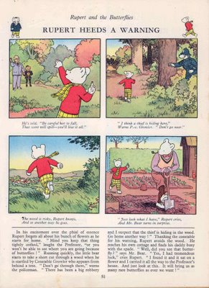
http://qwertyrob.blogspot.com/2007/10/rupert-principle.html

Slide 20

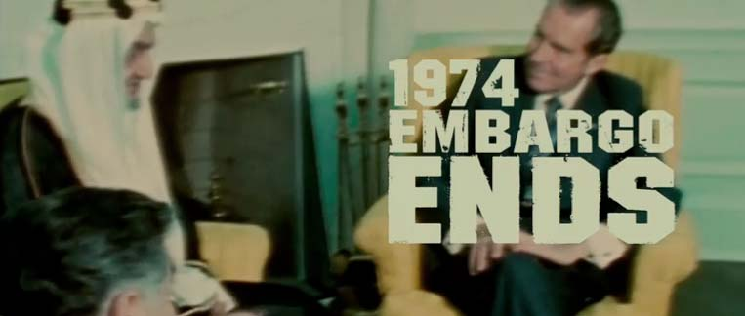

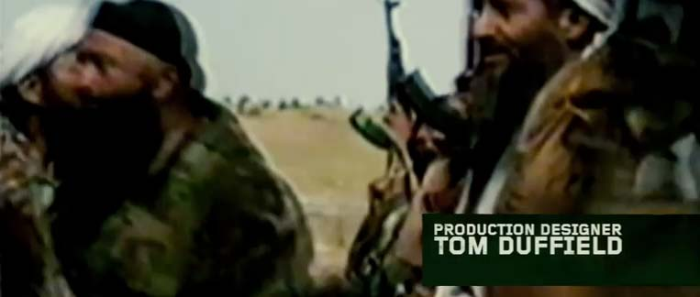
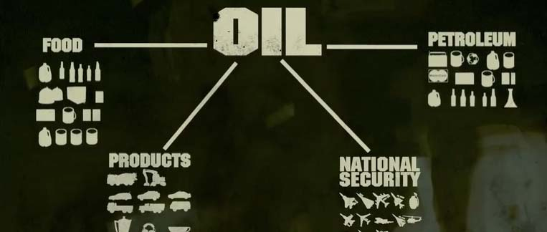
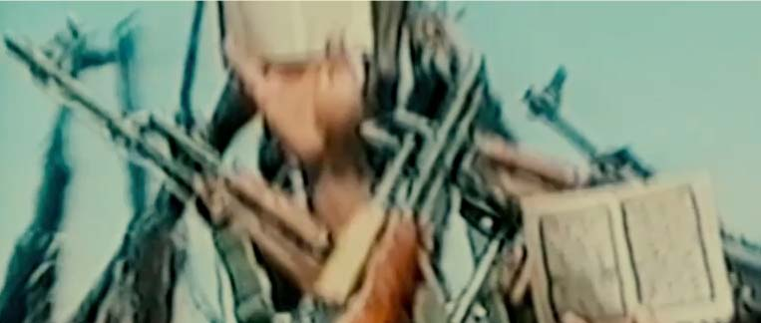



be aware of the stereo qt/ ql
http://www.spike.com/video-clips/jgu427/the-kingdom-opening-credits

Slide 21
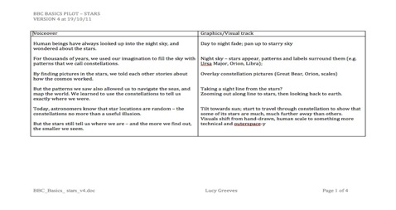
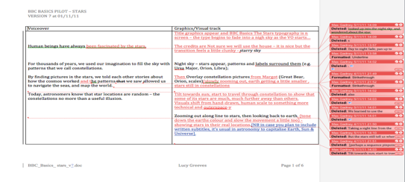
The script is a rehearsal studio and an improv space
Early Scripts
Exist as collaborative documents – make sure everyone has an updated version. One column for VO and one for graphics.These form the backbone of the process that iterates both VO and video tracks
VO/graphics matching
Match the sentences even if some spacing develops in either column
Later Scripts
Should bear the patina of changes as more ideas are added and then editted out
VO Scripts
Should be printed in 12/13pt for the actor to read. Always have lots of paper copies for the recording.

Slide 22

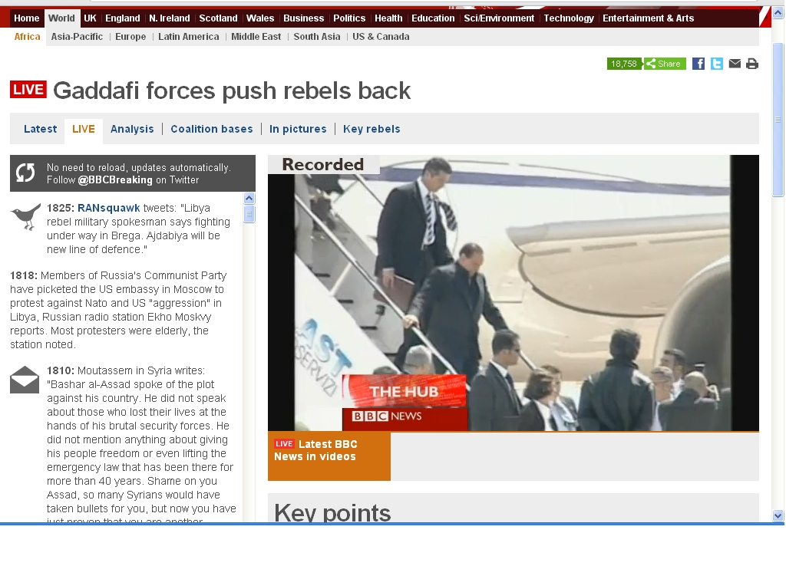
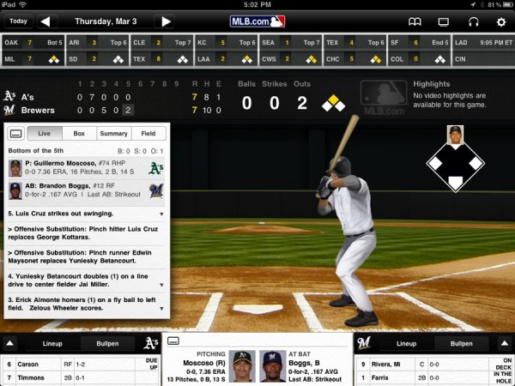
SHOW don’t and TELL

Slide 23
Media
3/5
Analytics
Present a human voice
of data

Slide 24
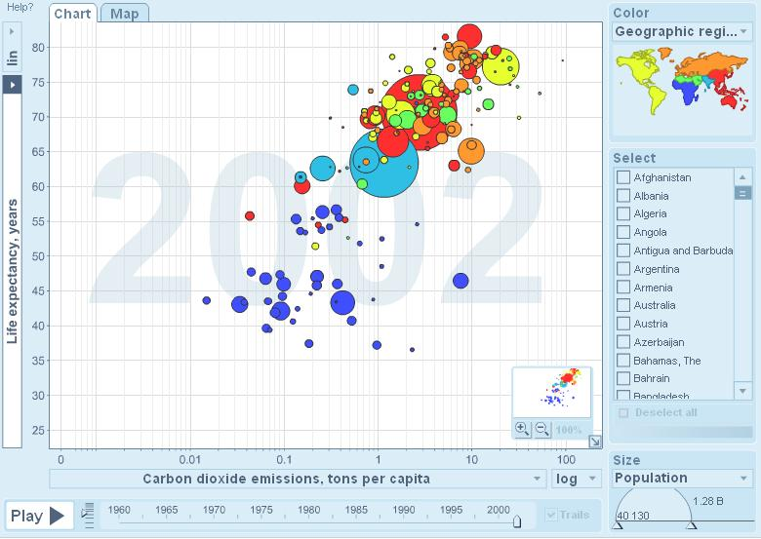
3. Present a human voice to data

Slide 25
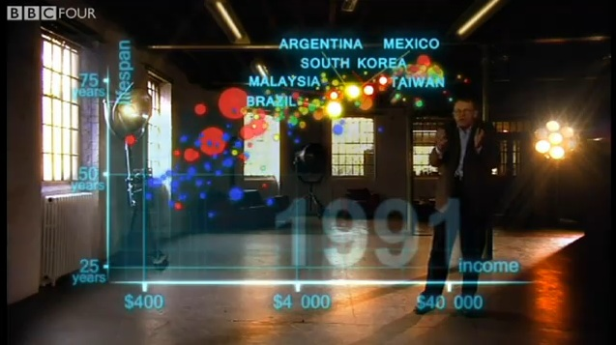
3. Present a human voice to data

Slide 26
3. Present a human voice to data

Slide 27
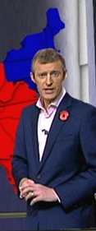
http://news.bbc.co.uk/1/hi/world/americas/us_elections_2008/7707170.stm

Slide 28
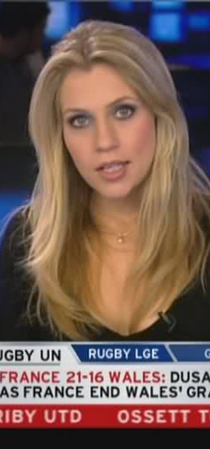
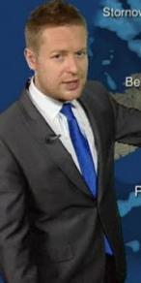
3. Present a human voice to data

Slide 29
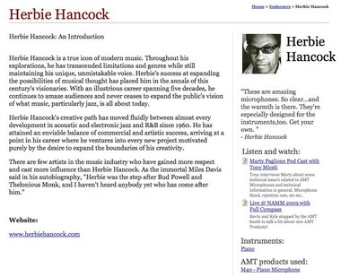
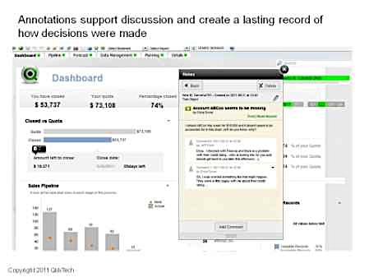

All human life is here…
beyond social design -
Directive and Discursive

Slide 30
Media
4/5
Analytics
Use the visual strengths of medium

Slide 31
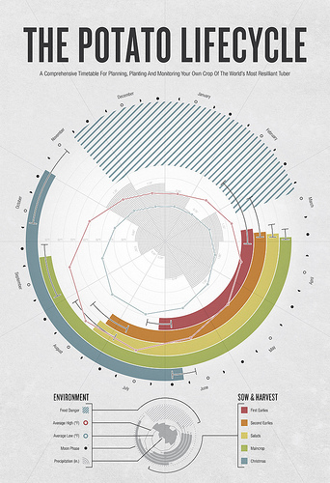
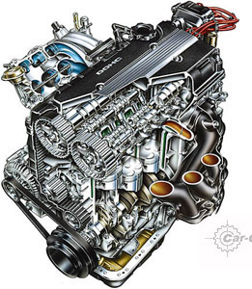
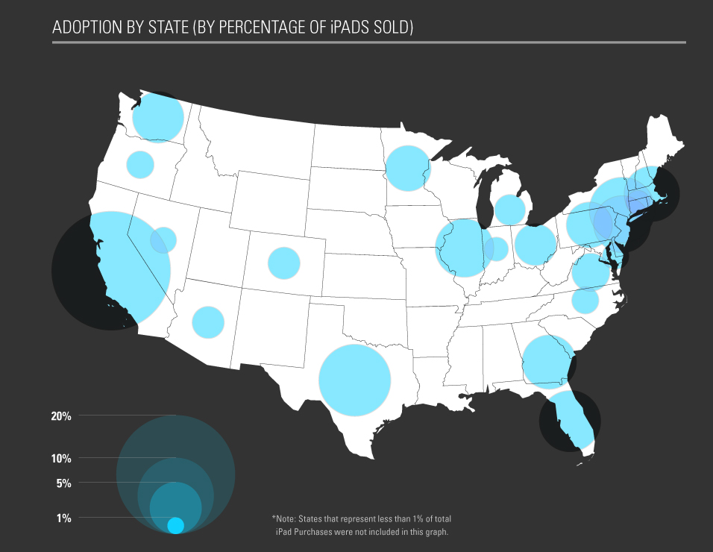

Doesn’t need to look
like a diagram

Slide 32



Slide 33

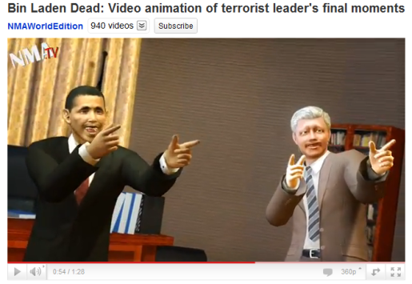
Keep it real

Slide 34

Thanks…
The Experience Economy
Gilmour, Pine
REAL FAKE
(obviously
Not true
REAL REAL
(genuine
first-hand)
Is what it says it is
FAKE FAKE
(deceitful
Misleading)
FAKE REAL
(honest
abstraction)
Is NOT what it says it is
Is NOT
True to
itself
Is True
to
itself

Slide 35
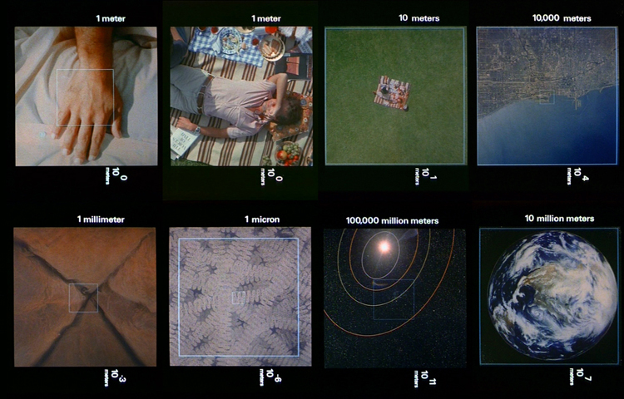

Slide 36
FLATLAND 2012
58
Right now you are reading 58 characters of western script
But not including these bits
(including spaces)

Slide 37
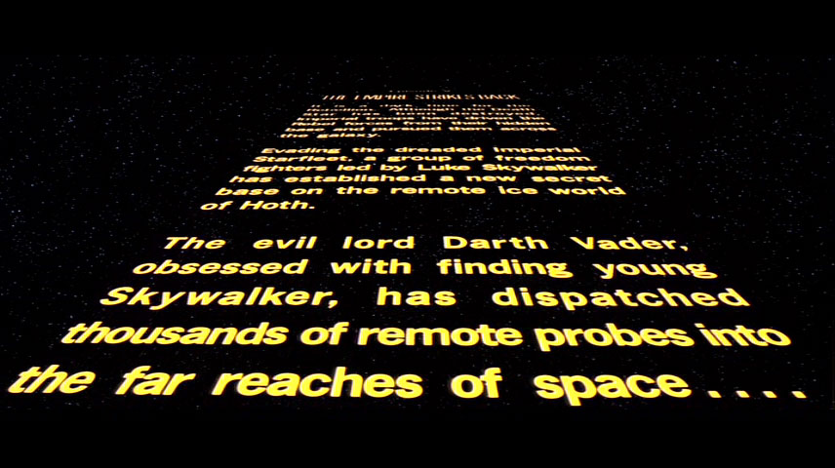
Z

Slide 38
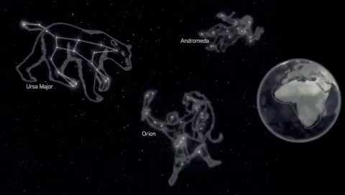

Slide 39
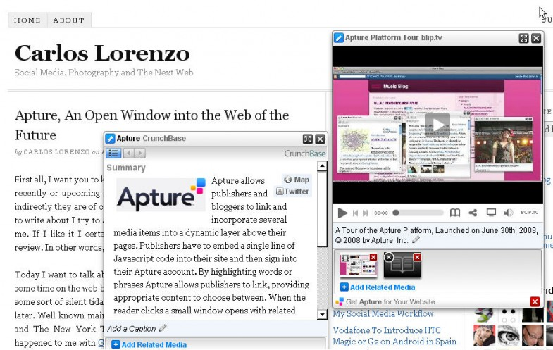
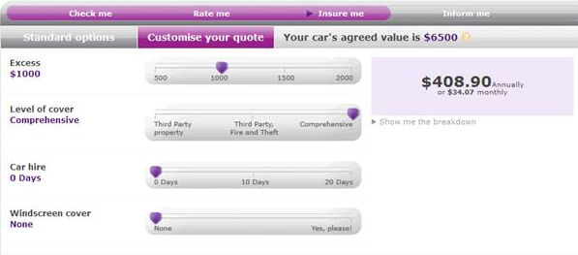
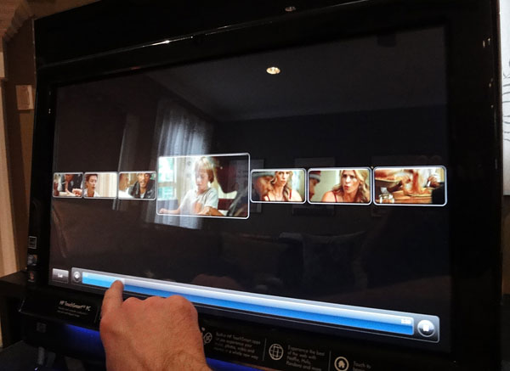
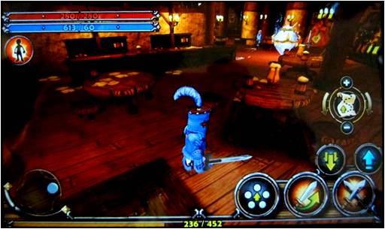
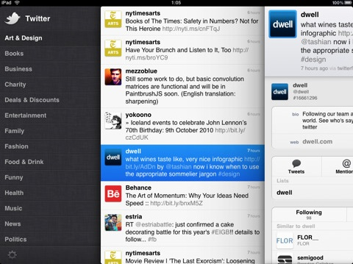
page+
True to
The web
Real Time
Layers
Overlays
Preview
Leaves

Slide 40
Media
5/5
Analytics
Spread data socially

Slide 41
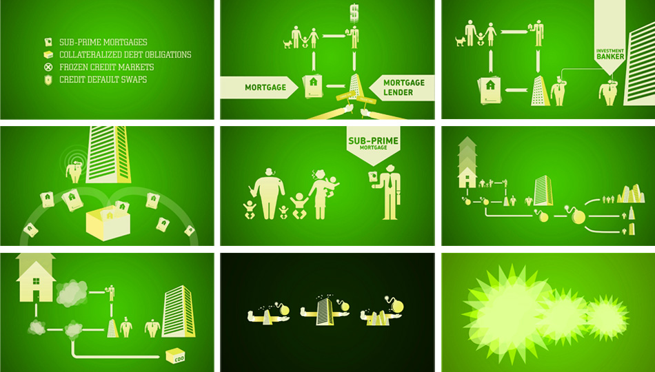

Slide 42
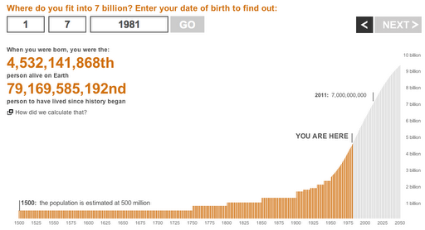

Slide 43
Media
Summary
Present a human
voice of data
Articulate data
into stories
Engage through
z-space
Inform and
learn from
each other
Analytics
Show multi-
modal data
Spread data
socially

Slide 44
Thanks
mg@aftertheflood.com

